Slide 1
Please do the following:
Have out your annotated article, t-chart, and a writing utensil
Clear your desk other than these items
For the discussion prep:
  Top is YOUR claim about topic with three reasons/evidence (can cross off two)
  Bottom THREE is finding three arguments, from EITHER SIDE, that you want to talk about!

Slide 2
How discussion will be graded
  You must earn a total of 5 points
  Points:
  1 for speaking, using evidence from text
  1 for using accountable talk
  1 for inviting others in
  1 for asking a question
  1 for clarifying a question

Slide 3
Accountable talk
I agree with _____ because
I disagree with ______ because
I was a little confused by _______ because
Could you please clarify __________?
This reminded me of __________ because
I predict __________ because

Slide 4

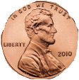

Make sure you get your two cents in!
Each time you talk, move ONE penny to the top of your desk
Listen to what other people are saying and ADD on to their input

Slide 5
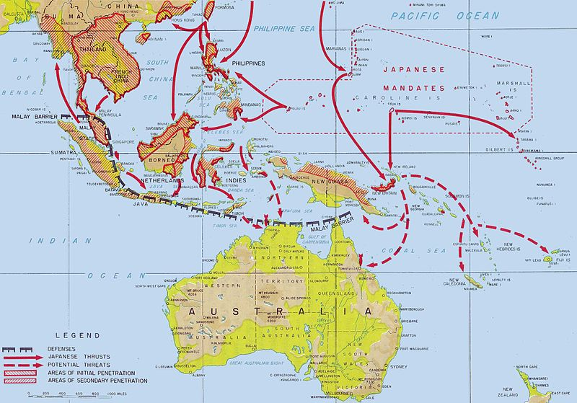
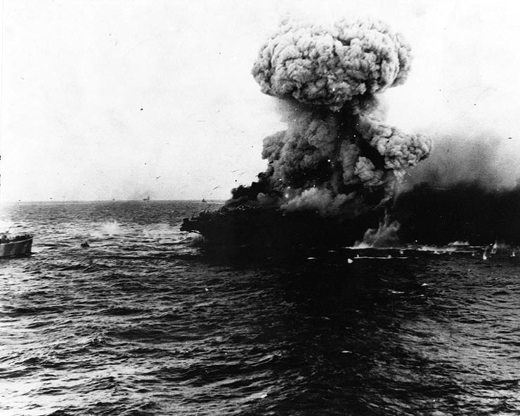
Battle of Coral Sea
  -- May 1942
  Admiral Chester Nimitz (U.S. Navy)
  Japan planning on invading Port Moresby New Guinea (would then be able to invade Australia
  Involved over 60 ships and 250 airplanes
  Neither side won, but kept Japan from taking Australia

Slide 6
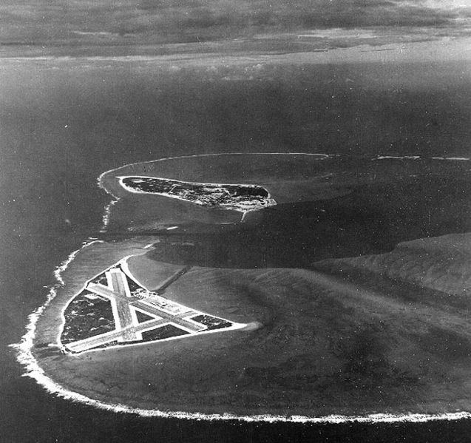
Battle of Midway
U.S. knew ahead of time about attack on Islands
June 4th, 1942
Seven aircraft carriers and over 500 airplanes
U.S. planes attack Japanese aircraft carriers (planes refueling), sink four aircraft carriers

Slide 7
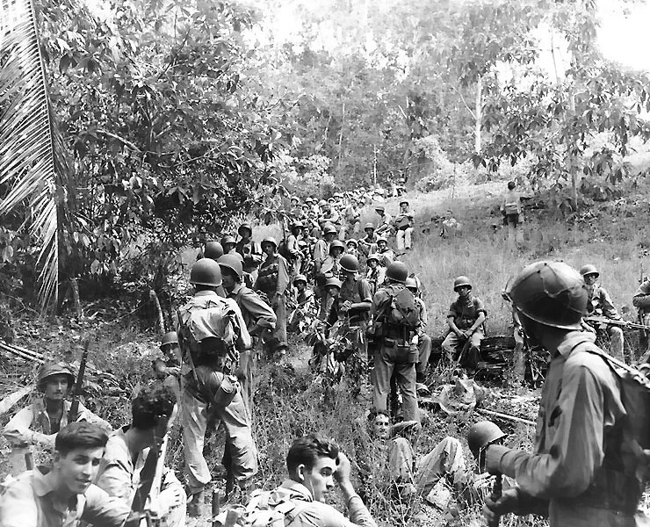
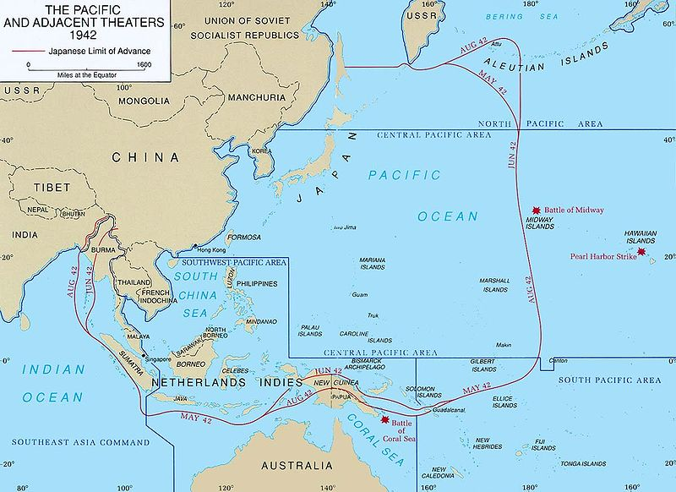
Guadalcanal
One of Solomon Islands
Fighting lasted six months (August 1942-Feb. 1943)
Rainy, jungle
Average marine lost 20-40 pounds during the fighting

Slide 8
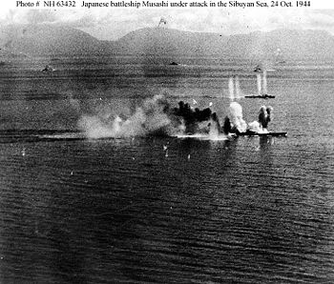
Battle of Leyte Gulf
Largest Naval battle ever fought
Involved over 200 ships and 2,000 airplanes
Helped U.S. take the Philippines back

Slide 9
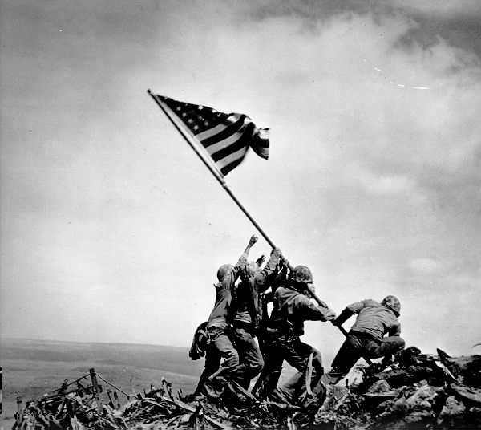
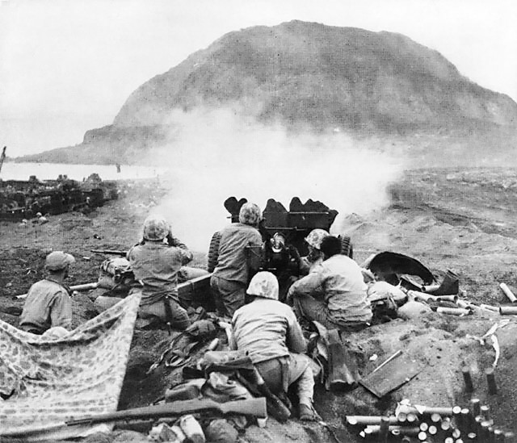
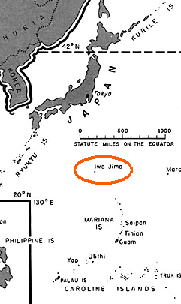
Iwo Jima
3 mile long volcanic island
Japanese had dug over 10 miles of tunnels
Were told to kill 10 Americans before they died
Of over 18,000 Japanese troops, only 216 were taken prisoner, rest were killed or missing!

Slide 10
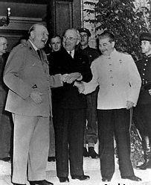
Potsdam Declaration
Issued on July 26th, 1945
Stalin, Churchill, and Truman met in Potsdam Germany to discuss different war issues
Declaration was to Japan
  Unconditional Surrender or face “prompt and utter destruction.”

Slide 11
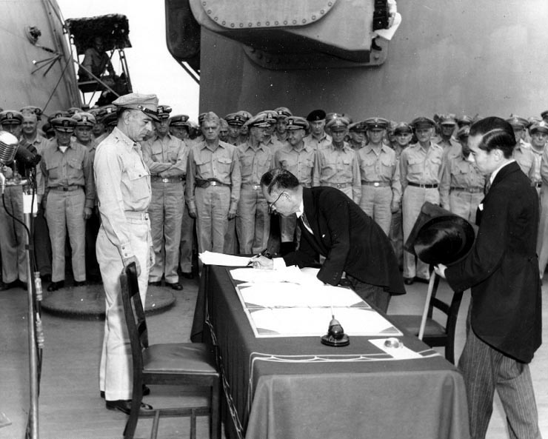
Japanese Surrender
1st bomb dropped on August 6th
2nd on August 9th
On August 15th, Emperor Hirohito went over radio saying Japan would surrender (1st time public had heard his voice)
September 2nd Japanese surrender on U.S.S. Missouri

Slide 12
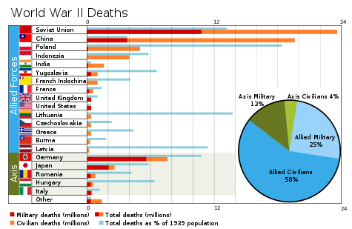

Slide 13
Station One: Creating the bomb
After considering what Einstein recommended, Roosevelt was persuaded that if the bomb could be built, the United States should be the first nation to build it. The development of the atomic bomb started in May 1942, six months after U.S. entrance into the war, and was code-named The Manhattan project. It cost over $2.5 billion and required the construction of the biggest industrial complex ever built. It employed over 590,000 people.
Plants were built to produce the elements needed for the bomb. A giant laboratory was created at Los Alamos, New Mexico. The town became a secret city – the people who worked there could not tell their relatives where they were or what they were working on. And top scientists constructed the first nuclear reactor under the football stadium at the University of Chicago. Since time was so important, all this work was done under tremendous anxiety and tension.

Slide 14
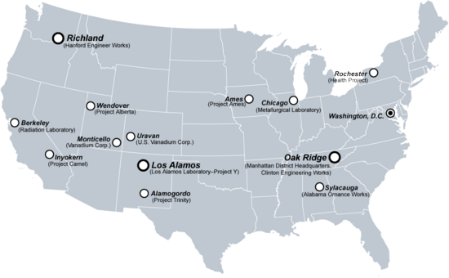
Key locations for developing the bomb

Slide 15
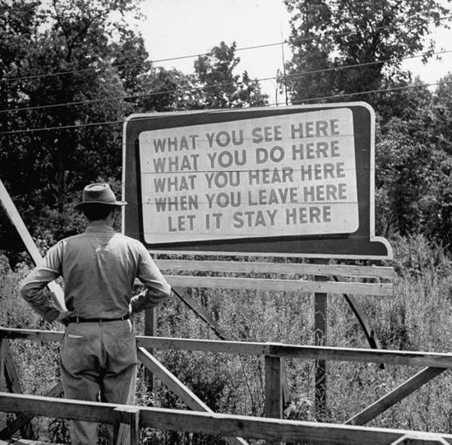
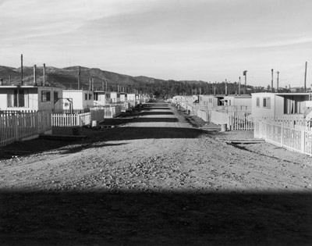

Slide 16
Station Two: Nuclear Test
The first nuclear chain reaction was achieved on December 2, 1942. This proved that the theory behind the project was correct. 32 months later, on July 16, 1945, the first atomic bomb was exploded in a remote desert in New Mexico. Scientists and others who watched from five miles away were staggered at its devastating effects.
So secret was the Manhattan Project that when Truman took over the presidency after Roosevelt’s death, even he did not know about it. Later Truman said, “I regarded the bomb as a military weapon and never had any doubt that it should be used. The atomic bomb was no great decision, not any decision you had to worry about.”

Slide 17
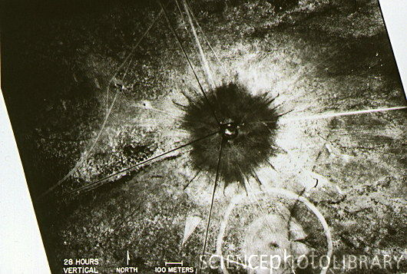
Manhattan Project. Aerial view of 'Ground Zero' at the Los Alamos site, New Mexico USA, photographed 28 hours after the detonation of the world's first atomic bomb. The dark zone in the center of the picture is an area of glass made by the effect of intense heat from the bomb on the sand of the desert floor. The bomb, code name Trinity, was detonated at 5.29 am local time on 16 July 1945, and had an explosive power equivalent to 21,000 tons of TNT. The flash from the explosion was seen 250 miles away. In an attempt to keep the project secret, the Army reported the blast as "...an accident at an ammunition dump."

Slide 18
Station Three: Okinawa
April 1, 1945-June 21, 1945 (Okinawa was only 340 miles away from Japan, less than the distance from Reno to Las Vegas). To some, this battle was to be a preview of what a land invasion of mainland Japan would be like.
Last and biggest of the Pacific island battles of World War II, the Okinawa campaign involved the 287,000 troops of the U.S. Tenth Army against 130,000 soldiers of the Japanese Thirty-second Army. At stake were air bases vital to the projected invasion of Japan.
The attack on Okinawa had taken a heavy toll on both sides. The Americans lost 7,373 men killed and 32,056 wounded on land. At sea, the Americans lost 5,000 killed and 4,600 wounded. The Japanese lost 107,000 killed and 7,400 men taken prisoner. It is possible that the Japanese lost another 20,000 dead as a result of American tactics whereby Japanese troops were incinerated where they fought.
The Americans also lost 36 ships. 368 ships were also damaged. 763 aircraft were destroyed. The Japanese lost 16 ships sunk and over 4,000 aircraft were lost.

Slide 19
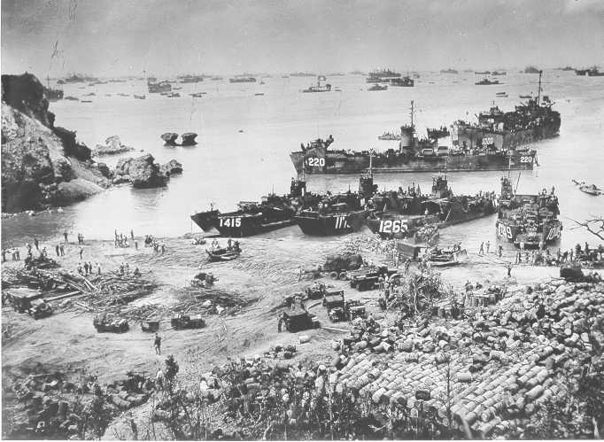
The invasion of Okinawa, like the majority of battles in the Pacific campaign, was amphibious.

Slide 20
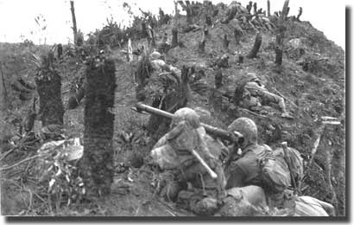

Slide 21
Station Four: Firebombing
Many in the Roosevelt and Truman administrations felt that the prospect of using the atomic bomb was no more inhumane than the massive fire bombing raids that had taken place over Germany and over Tokyo. In fact, the firebombing raid on Tokyo in March of 1945 did more damage and caused more casualties than the atom bomb in Hiroshima.

Slide 22
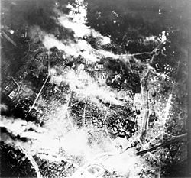
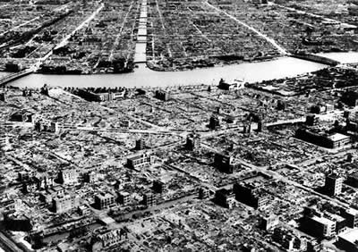
Firebombing went from 17 November 1944 and lasted until 15 August 1945, The Operation Meetinghouse air raid of 9–10 March 1945 was later estimated to be the single most destructive bombing raid in history. with 279 B-29’s dropping around 1,700 tons of bombs
Fire bombing killed an estimated 100,000 people, mostly civilians in Tokyo.

Slide 23
Station Five: Where to bomb?
The Target Committee at Los Alamos on May 10, 1945, recommended Kyoto, Hiroshima, Yokohama, and the arsenal at Kokura as possible targets. The committee rejected the use of the weapon against a strictly military objective because of the chance of missing a small target not surrounded by a larger urban area. The psychological effects on Japan were of great importance to the committee members.
They also agreed that the initial use of the weapon should be sufficiently spectacular for its importance to be internationally recognized. The committee felt Kyoto, as an intellectual center of Japan, had a population "better able to appreciate the significance of the weapon." Hiroshima was chosen because of its large size, its being "an important army depot" and the potential that the bomb would cause greater destruction because the city was surrounded by hills which would have a "focusing effect".

Slide 24
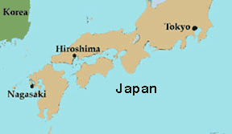

Slide 25
Station six: The bombs
Little Boy
"Fat Man."
"Little Boy" is the nick name given to the atomic bomb dropped on Hiroshima on August 6, 1945. It was Monday morning.
Weight: 9700 pounds, 120 inches long, 28 inches in diameter
Little Boy was dropped from the Enola Gay, one of the B-29 bombers that flew over Hiroshima on that day.
The Nagasaki Bomb
It was 128 inches (3,300 mm) long, 5 feet (1.5 m) in diameter, and weighed 10,200 pounds (4,600 kg).
Compared to one used on Hiroshima, the Nagasaki bomb was rounder and fatter, so it was called "Fat Man.“
The bomb was supposed to be dropped on Kokura, but the weather was too cloudy and Nagasaki was chosen instead

Slide 26
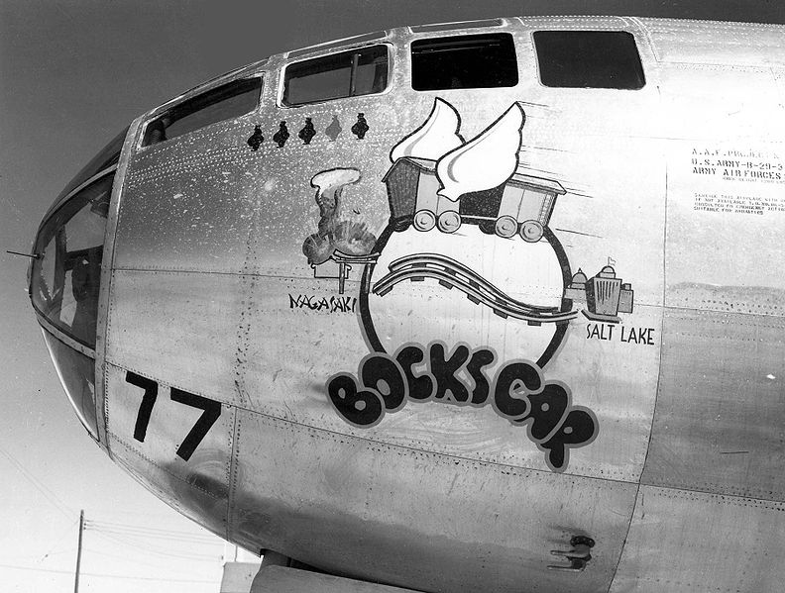
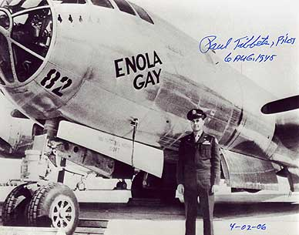
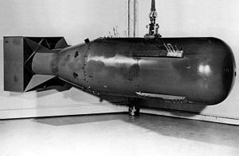
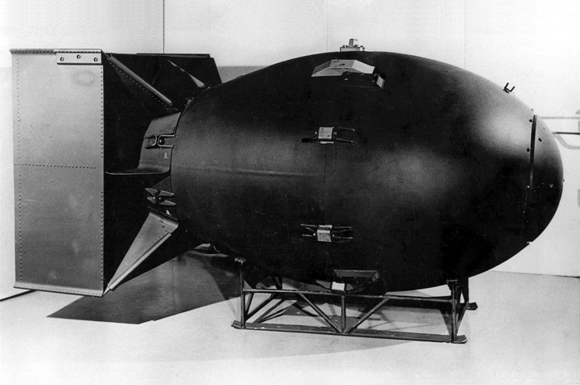
Paul Tibbets, Enola Gay Pilot
Bockcar, piloted by Frederick Bock
Fat Man
Little Boy

Slide 27
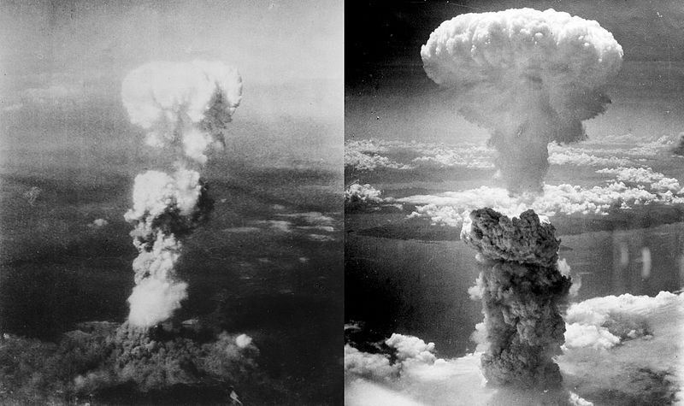
Hiroshima Nagasaki

Slide 28
Station Seven: The effects
The devastating effects of the atomic bombs were shocking. Of the 320,000 civilians and soldiers in Hiroshima, some 80,000, according to American figures, were killed instantly or severely wounded. Moreover, many survivors suffered from short- and long-term radiation poisoning.
When the Hiroshima bomb was dropped, the temperature at ground zero (the point of detonation) was several thousand degrees centigrade. At the core of the blast, the temperature was 50 million degrees centigrade. The flash heat started fires a mile away. Stone walls, steel doors, and asphalt pavement glowed red hot. The heat burned the black lettering from books and newspapers, and fused clothing to skin. More than a mile from the epicenter, men had their caps etched onto their scalps, women their kimono patterns imprinted on their bodies, and children their socks burned into their legs.
The Hiroshima blast leveled the city. At Shima Clinic, for example, the stone columns were rammed straight down into the ground. The entire building collapsed, and the occupants were vaporized. 62,000 buildings out of a total of 90,000 were destroyed. All utilities and transportation services were wrecked.

Slide 29
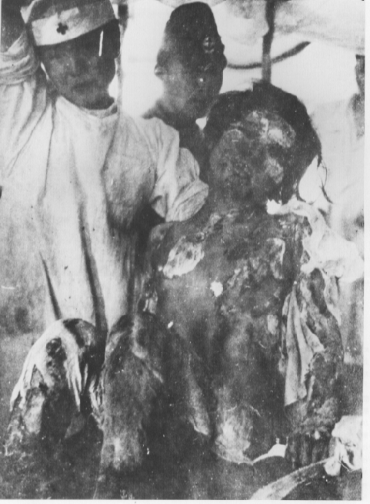
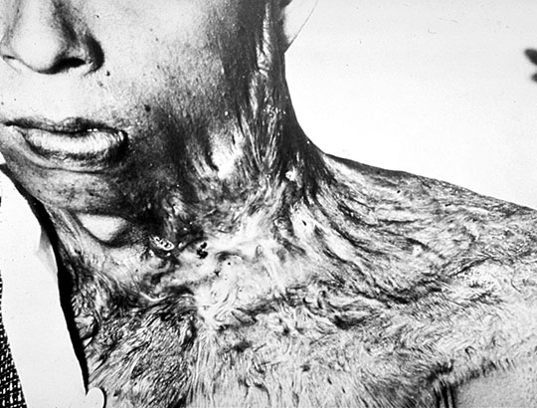
Within the first two to four months of the bombings, the acute effects killed 90,000–166,000 people in Hiroshima and 60,000–80,000 in Nagasaki, with roughly half of the deaths in each city occurring on the first day. The Hiroshima prefecture health department estimated that, of the people who died on the day of the explosion, 60% died from flash or flame burns, 30% from falling debris and 10% from other causes.

Slide 30
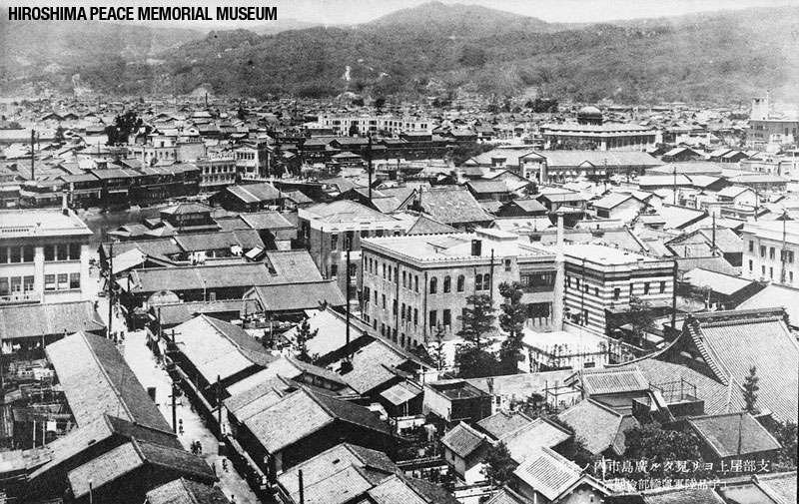

Slide 31
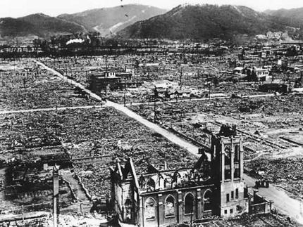
Atomic aftermath: the destruction of Hiroshima, Japan, after the bombing in 1945.

Slide 32
Steps to writing:
Finish annotating/t-chart
Place information in Buckets
Make a CLAIM, with two reasons. Ex. Due to the fact he has the most $ and has the best statistics, Michael Jordan is the best basketball player of all time.
Do your INTRO: HOOK, background information over the decision regarding the bomb, restate question, write your claim
Body paragraphs: Mini-claim, support with TWO pieces of EVIDENCE. Make sure your REASONING clearly explains how your evidence proves your claim
Conclusion: Restate claim, MAKE AN ALTHOUGH statement, finish by possibly going BACK to your HOOK.

